Slide 1

Departmemt of Computer Science and Engineering
Expert-Agnostic AI for Intelligent Tutoring Systems: Leveraging Self-Supervised Knowledge Mining
PRESENTED BY
T.Ramesh (22471A05K3)
Sk.M.Fayaz (22471A05J0)
K.Y.Jakraiah (22471A05K9)
Under the Esteemed Guidance of
Dr. S.V.N. Srinivasu,_{B.Tech.,M.Tech.,Ph.D.,}
Assoc.Professor,
Department of Computer Science and Engineering,
Narasaraopeta Engineering College (Autonomous),
Narasaraopet - 522 601.

Slide 2
OUTLINE
Abstract
Introduction
Problem Statement
Literature Survey
Research Gaps
Objectives
Methodology
Block Diagram/Flow Diagram
Implementation
Results and Analysis
Conclusion
Future Scope
References
Q&A
Acknowledgement

Slide 3
ABSTRACT
Expert-tailored annotations and domain-specific rules are usually unavoidable in traditional Intelligent Tutoring Systems (ITS), restricting scalability and flexibility. This paper presents a new expert-agnostic approach to intelligent tutoring based on self-supervised learning to promote more personalized education with-out depending on domain experts. We develop and evaluate multiple deep learning models—GRU, BiLSTM, LSTM, CNN, Transformer, MLP, and hybrid Embedded GRU CNN—trained on student interaction datasets using automatic representation learning techniques. Our approach leverages the sequential nature of learning behaviours and embeds contextu alized features to identify optimal learning interventions. Among the tested architectures, Embedded GRU-CNN and BiLSTM, CNN models demonstrated superior accuracy (up to 99%) in predicting learner needs and engagement levels. The findings demonstrate substantial student modelling performance improve ment without hand-crafted labels, affirming the promise of self supervised methods in ITS. The work opens to scalable, domain agnostic intelligent tutoring systems that can adapt and provide feedback in real time, a step toward democratizing AI-facilitated education for multiple types of learners.

Slide 4
INTRODUCTION
Traditional Intelligent Tutoring Systems depend on expert-labeled data, limiting scalability.
The proposed approach uses self-supervised learning to learn from raw interaction data.
The EdNet-KT4 dataset with over 300,000 student interactions is used for evaluation.
Deep learning models such as GRU, LSTM, BiLSTM, CNN, Transformer, and GRU-CNN are applied.
The system achieves high accuracy and personalization without expert intervention.

Slide 5
PROBLEM STATEMENT
Traditional Intelligent Tutoring Systems rely on expert-labeled data, limiting scalability and adaptability across domains. There is a need for a self-supervised, expert-agnostic model that learns directly from raw student interactions to predict performance and engagement effectively.

Slide 6
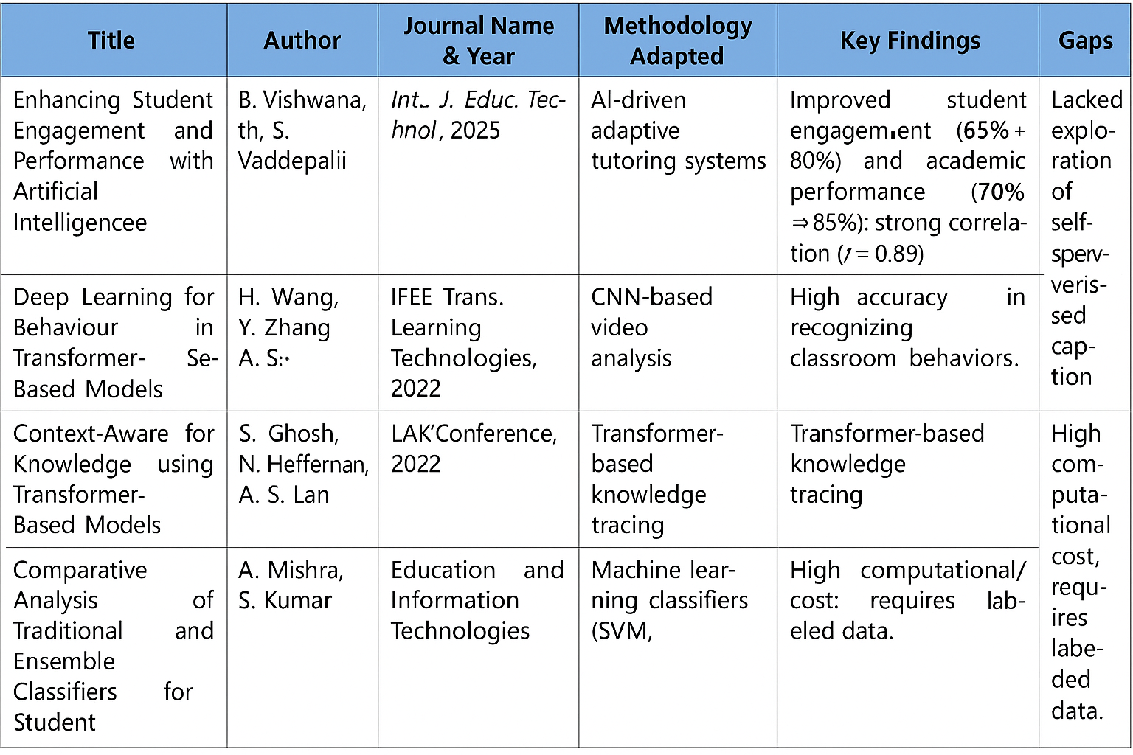
LITERATURE REVIEW

Slide 7
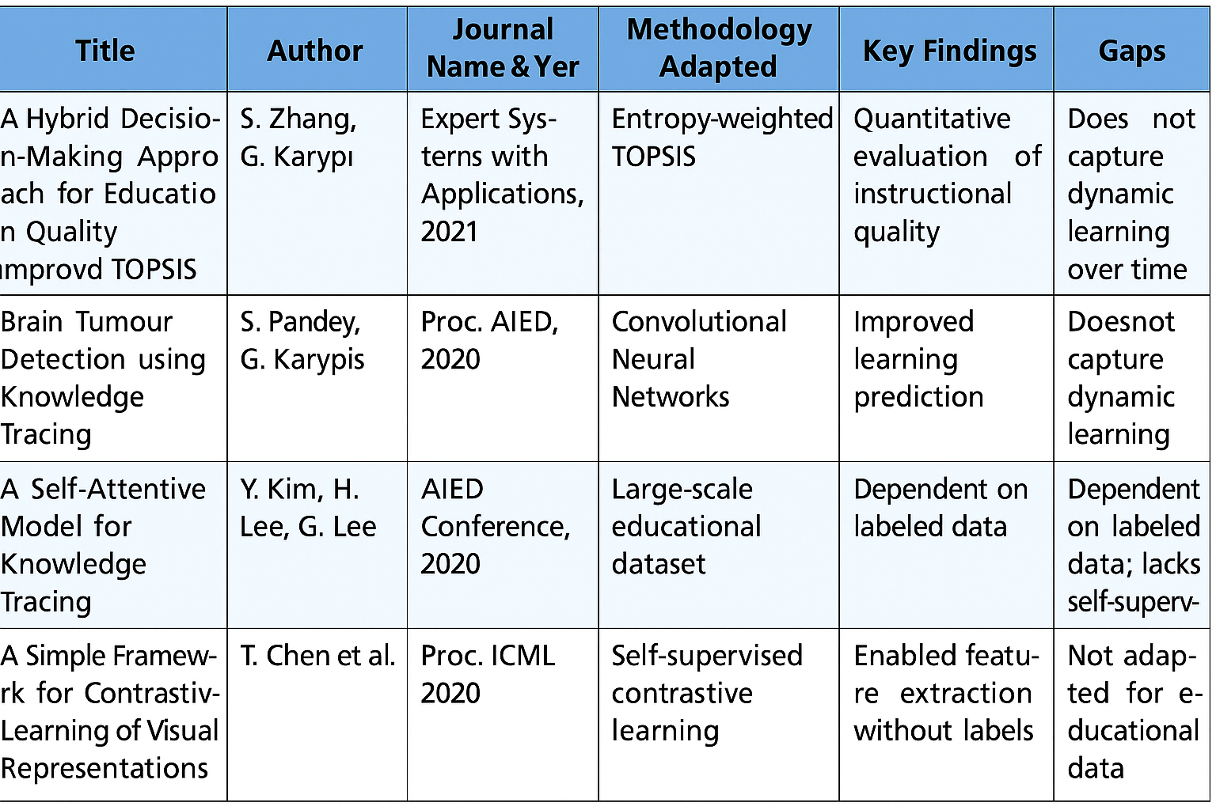

Slide 8
RESEARCH GAPS
Expert Dependency: ITS still rely on expert-labeled data, limiting scalability.
Lack of Self-Supervised Approaches: Few works use self-supervised learning on unlabeled data.
Limited Feature Integration: Models fail to combine temporal and contextual features.
Domain-Specific Limitations: ITS models lack generalization across subjects.
Absence of Real-Time Adaptivity: Few systems provide adaptive, real-time feedback.

Slide 9
OBJECTIVES
To develop an expert-agnostic Intelligent Tutoring System using self-supervised learning.
To train multiple deep learning models (GRU, LSTM, BiLSTM, CNN, Transformer, GRU-CNN) on student interaction data.
To analyze training and testing loss curves to evaluate convergence and overfitting behavior.
To design a scalable, adaptive, and domain-independent ITS framework for personalized learning.

Slide 10
METHODOLOGY
1.Dataset Selection: The EdNet-KT4 dataset containing over 300,000 student interaction records was used to model learning behavior and performance.
2.Data Preprocessing: Raw data was cleaned by removing incomplete sessions, handling missing values, and encoding categorical variables such as action type, item ID, and platform.
3.Feature Engineering: Extracted key behavioral and temporal features such as time difference between interactions, rolling averages, and sequence construction to capture learning patterns.
4. Sequence Preparation: Interaction data was organized into fixed-length sequences (100 interactions per user) and transformed into 3D tensors suitable for deep learning models.
5. Model Development: Implemented seven models — MLP, LSTM, BiLSTM, GRU, CNN, Transformer, and GRU-CNN (hybrid) — for predicting student performance using self-supervised learning.
6. Training and Optimization: Models were trained using Adam optimizer and Binary Cross-Entropy loss, with dropout and early stopping to prevent overfitting.
7. Performance Evaluation: Evaluated models using Accuracy, Precision, Recall, and F1-score, along with training vs testing loss plots to study convergence and generalization.

Slide 11
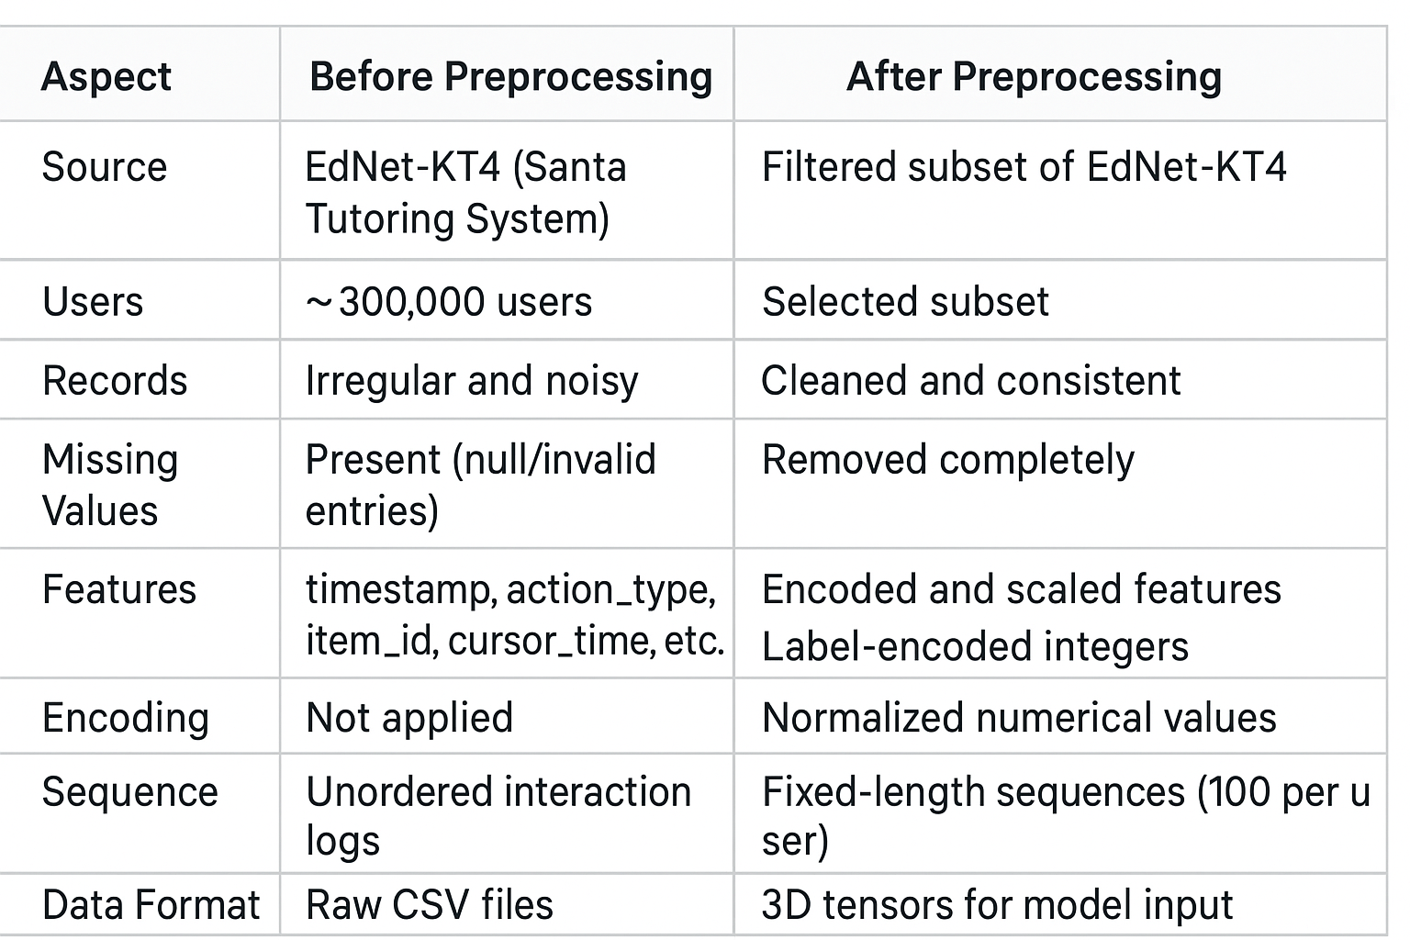
Dataset Description After Data Preprocessing
Dataset Description Before and After Data Preprocessing

Slide 12
System Requirements
Hardware Requirements
Processor : intel Core i5
Cache memory : 4MB(Megabyte)
RAM : 12.7GB (gigabyte)
Hard Disk : 166.8GB
Compute Engine : T4 GPU
Software Requirements
Operating System : Windows 10, 64-bit OS
Coding Language : Python
Python distribution : Google Colab Pro , Flask
Browser : Any Latest Browser like Chrome

Slide 13
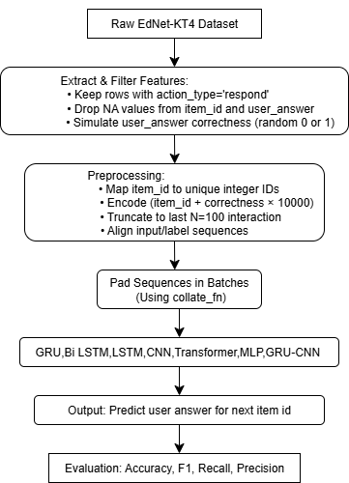
BLOCK DIAGRAM OR FLOW DIAGRAM

Slide 14
IMPLEMENTATION
Phase 1: Mount Drive & Import Libraries
from google.colab import drive
drive.mount('/content/drive')
import os
import torch
import torch.nn as nn
from torch.utils.data import Dataset, DataLoader
random
from sklearn.metrics import accuracy_score, precision_score, recall_score, f1_score, confusion_matrix
DESCRIPTION:-
Loads Google Drive for dataset access and imports all required Python, PyTorch, and evaluation libraries.
Phase 2: Set Random Seed
# Reproducibility
def set_seed(seed=42):
torch.manual_seed(seed)
np.random.seed(seed)
random.seed(seed)
torch.backends.cudnn.deterministic = True
set_seed()
Description:
Ensures reproducible results by fixing randomness across NumPy, PyTorch, and Python.
Phase 3: Load and Preprocess User CSV Files
def load_user_csvs(folder_path, limit_users=3000):
files = sorted([f for f in os.listdir(folder_path) if f.endswith('.csv')])[:limit_users]
item_id_map = {}
item_counter = 1
data = []
for fname in files:
try:
path = os.path.join(folder_path, fname)

Slide 15
q_ids, corrects = [], []
for _, row in df.iterrows():
raw_q = row['item_id']
if raw_q not in item_id_map:
if len(q_ids) > 2:
data.append({'q': q_ids, 'a': corrects})
except:
continue
print(f"✅ Loaded {len(data)} valid users.")
return data, item_counter
Description:
Reads user interaction CSVs, filters valid responses, encodes item IDs, and builds question–answer sequences.
Phase 4: CNN_KT Model Definition
class CNN_KT(nn.Module):
def __init__(self, input_dim, embed_dim=128, num_filters=64, kernel_size=3):
super(CNN_KT, self).__init__()
self.embedding = nn.Embedding(input_dim, embed_dim)
self.conv1 = nn.Conv1d(in_channels=embed_dim, out_channels=num_filters, kernel_size=kernel_size, padding=1)
self.relu = nn.ReLU()
self.dropout = nn.Dropout(0.2)
self.fc = nn.Linear(num_filters, 1)
def forward(self, x):
embed = self.embedding(x) # [batch, seq_len, embed_dim]
embed = embed.transpose(1, 2) # [batch, embed_dim, seq_len]
conv_out = self.relu(self.conv1(embed)) # [batch, filters, seq_len]
conv_out = conv_out.transpose(1, 2) # [batch, seq_len, filters]
pred = self.fc(self.dropout(conv_out)).squeeze(-1) # [batch, seq_len]
return pred
Description:
Defines a 1D-CNN based knowledge tracing model that learns patterns in student answer sequences to predict next-step correctness.
Phase 5: Dataset Class and Padding Function
class KT_Dataset(Dataset):
def __init__(self, data, max_seq=100):
self.data = data
self.max_seq = max_seq
def __len__(self):
return len(self.data)

Slide 16
def __getitem__(self, idx):
q_seq = self.data[idx]['q'][-self.max_seq:]
a_seq = self.data[idx]['a'][-self.max_seq:]
seq_len = min(len(q_seq), len(a_seq))
if seq_len < 3:
return None
q_seq = q_seq[:seq_len]
a_seq = a_seq[:seq_len]
input_seq = [q + a * 10000 for q, a in zip(q_seq, a_seq)]
label_seq = a_seq[1:]
input_seq = input_seq[:-1]
return torch.LongTensor(input_seq), torch.FloatTensor(label_seq)
torch.cat([seq, torch.zeros(max_len - len(seq))]) for seq in inputs ])
padded_labels = torch.stack([
torch.cat([seq, torch.zeros(max_len - len(seq))]) for seq in labels ])
return padded_inputs.long(), padded_labels.float()
Description:
Converts sequences into model-ready inputs, encodes (question, answer), and pads variable-length sequences for batching.
Phase 6: Training and Evaluation Functions
def train(model, train_loader, optimizer, criterion, device):
model.train()
for epoch in range(50):
total_loss = 0
count = 0
for x, y in train_loader:
if x.nelement() == 0: continue
x, y = x.to(device), y.to(device)
optimizer.zero_grad()
output = model(x)
loss = criterion(output, y)
loss.backward()
optimizer.step()
total_loss += loss.item()
count += 1
print(f"Epoch {epoch+1}, Loss: {total_loss / max(count, 1):.4f}")
def evaluate(model, test_loader, device):
model.eval()
all_preds, all_labels = [], []

Slide 17
with torch.no_grad():
for x, y in test_loader:
if x.nelement() == 0: continue
x, y = x.to(device), y.to(device)
print("\n📊 Evaluation Metrics:")
print("Accuracy :", accuracy_score(all_labels, all_preds))
print("Precision:", precision_score(all_labels, all_preds))
print("Recall :", recall_score(all_labels, all_preds))
print("F1 Score :", f1_score(all_labels, all_preds))
print("Confusion Matrix:\n", confusion_matrix(all_labels, all_preds))
Description:
Implements the training loop using backpropagation and computes performance metrics like accuracy, precision, recall, F1-score, and confusion matrix.
Phase 7: Data Loading, Dataloaders, and Model Initialization
# Load dataset
data, input_dim = load_user_csvs("/content/drive/MyDrive/Project/dataset/KT", limit_users=10000)
# Train/test split
random.shuffle(data)
train_data = data[:int(0.8 * len(data))]
test_data = data[int(0.8 * len(data)):]
# Loaders
train_loader = DataLoader(KT_Dataset(train_data), batch_size=64, shuffle=True, collate_fn=pad_collate_fn)
test_loader = DataLoader(KT_Dataset(test_data), batch_size=64, collate_fn=pad_collate_fn)
# Model init
device = torch.device("cuda" if torch.cuda.is_available() else "cpu")
model = CNN_KT(input_dim=input_dim + 10000).to(device)
Description:
Splits data into train/test sets, creates dataloaders, initializes the CNN model, loss function, and optimizer.

Slide 18
Phase 8: Model Training, Testing, and Saving
# Train & evaluate
train(model, train_loader, optimizer, criterion, device)
evaluate(model, test_loader, device)
torch.save({
'model_state_dict': model.state_dict(),
'optimizer_state_dict': optimizer.state_dict(),
'input_dim': input_dim + 10000,
'model_config': {
'embed_dim': 128,
'num_filters': 64,
'kernel_size': 3
},
Description:
Runs full training, evaluates the model on test data, and saves the trained weights and a TorchScript version for deployment.

Slide 19
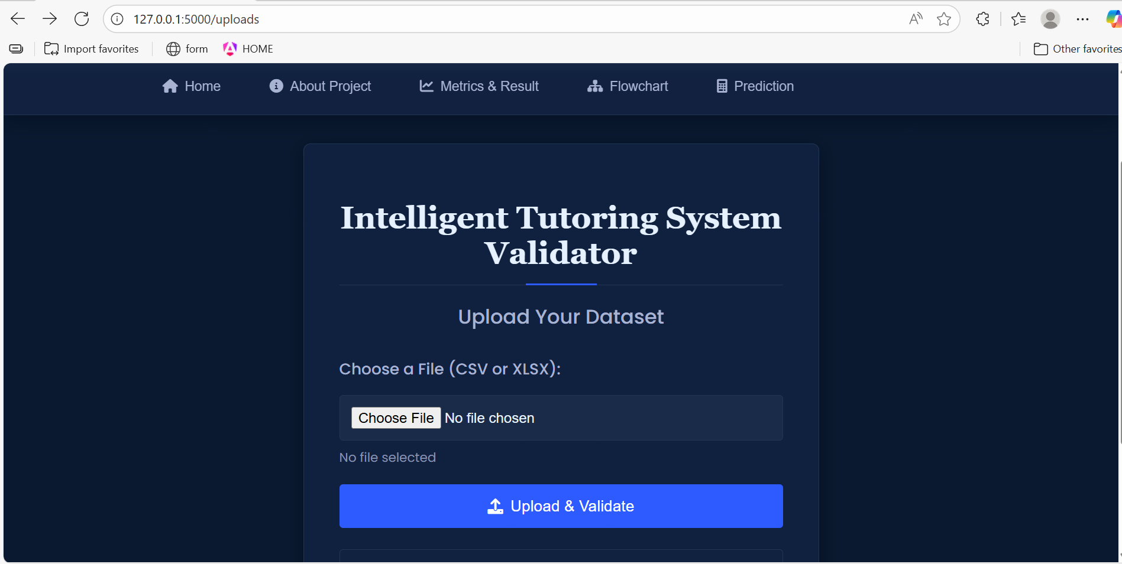
Prediction Page

Slide 20
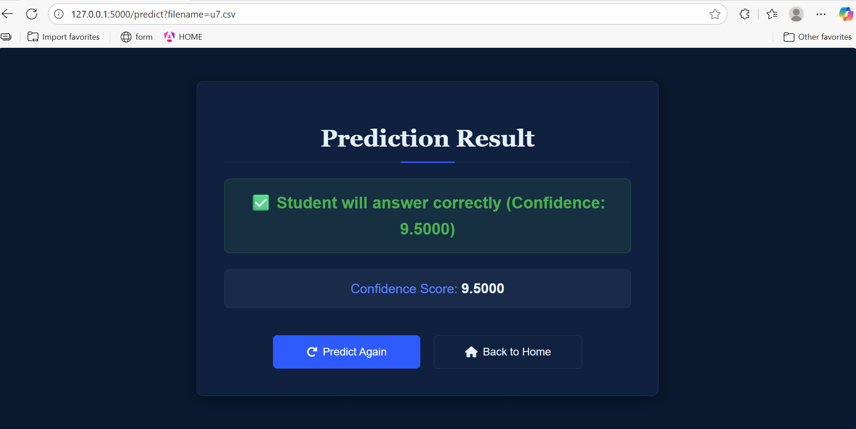
Prediction Results

Slide 21
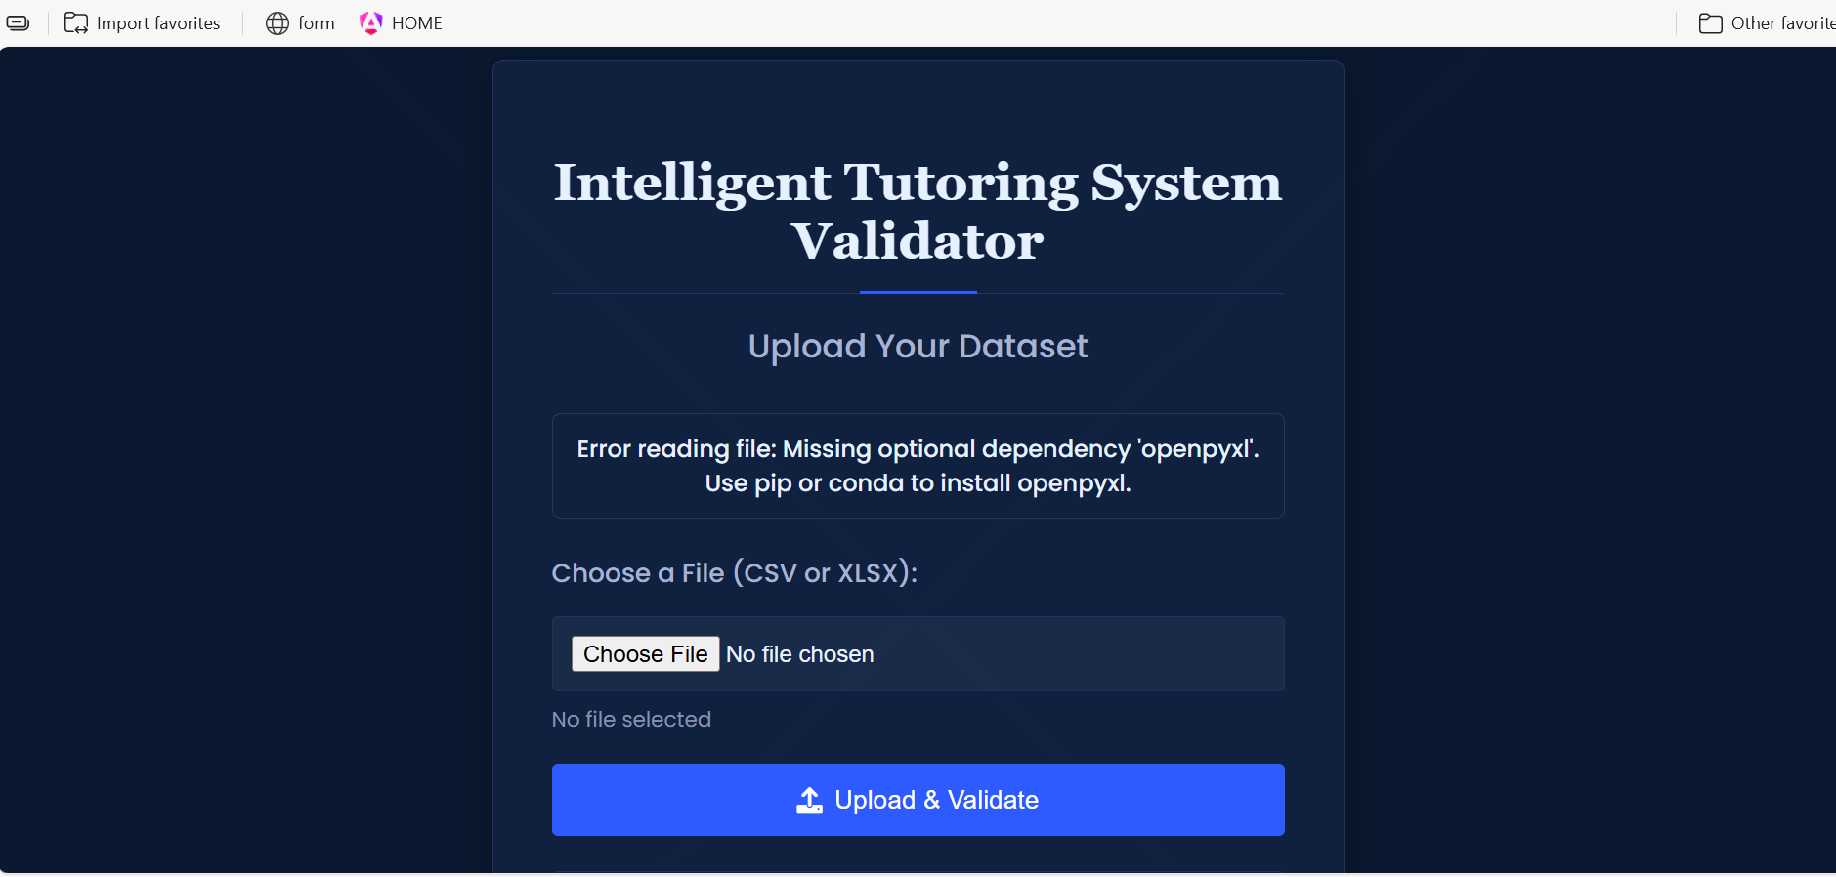
Error Reading File

Slide 22
RESULTS & ANALYSIS
Model Performance: Among all models, CNN (98.41%) and GRU-CNN (98.08%) achieved the highest accuracy, outperforming other architectures such as BiLSTM (95.62%), LSTM, GRU, Transformer, and MLP.
Learning Behavior Analysis: Training and testing loss curves showed that GRU-CNN demonstrated stable convergence and minimal overfitting, proving its robustness for sequential educational data.
Evaluation Metrics: Models were assessed using Accuracy, Precision, Recall, and F1-score, confirming that hybrid and convolutional models effectively captured both local and temporal learning patterns.
Key Findings: The results validate that self-supervised, expert-agnostic models can achieve high predictive accuracy and adapt to diverse learning behaviors without expert-labeled data.

Slide 23
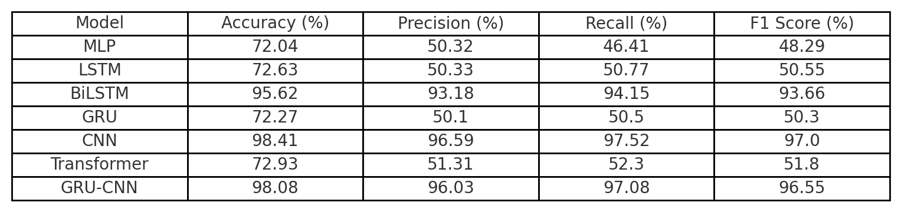
Evaluation Metrics :-

Slide 24
CONCLUSION
The proposed self-supervised, expert-agnostic ITS predicts student performance effectively without expert-labeled data.
CNN and GRU-CNN achieved the best results, proving strong generalization from raw interactions.
The system offers a scalable and adaptive framework for personalized, domain-independent learning.

Slide 25
FUTURE SCOPE
Integrate multimodal data like facial, voice, and text cues for better engagement detection.
Use reinforcement learning for adaptive and personalized feedback.
Test the system in low-resource educational environments.
Apply interpretability and fairness methods for ethical AI deployment.

Slide 26
REFERENCES
K. Cho et al., ”Learning phrase representations using RNN encoder-decoder for statistical machine transla tion,” in Proc. EMNLP, pp. 1724–1734, 2014.
S. Hochreiter and J. Schmidhuber, ”Long short-term memory,” Neural Computation, vol. 9, no. 8, pp. 1735–1780, 1997.
A. Graves and J. Schmidhuber, ”Framewise phoneme classification with bidirectional LSTM networks,” in Proc. 2005 IEEE Int. Joint Conf. Neural Networks, vol. 4, pp. 2047–2052.
D. E. Rumelhart, G. E. Hinton, and R. J. Williams, ”Learning internal representations by error propagation,” in Parallel Distributed Processing, vol. 1, MIT Press, 1986.
Y. LeCun et al., ”Gradient-based learning applied to document recognition,” Proc. IEEE, vol. 86, no. 11, pp. 2278–2324, 1988.
A. Vaswani et al., ”Attention is all you need,” Adv. Neural Inf. Process. Syst., vol. 30, 2017.
W. Yin et al., ”Comparative study of CNN and RNN for natural language processing,” arXiv preprint arXiv:1702.01923, 2017.

Slide 27
Y. Kim, H. Lee, and G. Lee, ”EdNet: A large-scale hierarchical dataset in education,” in Proc. AIED, 2020.
A. Raffel et al., ”Exploring the limits of transfer learning with a unified text-to-text transformer,” J. Mach. Learn. Res., vol. 21, no. 140, pp. 1–67, 2020.
X. Chen et al., ”Intelligent tutoring systems in higher education: A review,” Computers & Education, vol. 144, p. 103700, 2020.
B. D. Nye, ”Intelligent tutoring systems by the numbers: A review of 50+ years of research,” in Artificial Intelli gence in Education, Springer, 2015, pp. 1–12.
H. Wang, Y. Zhang, and X. Ma, ”Deep learning for behaviour recognition in classroom surveillance videos,” IEEE Trans. Learning Technologies, vol. 15, no. 1, pp. 24–36, 2022.
S. Pandey and G. Karypis, ”A self-attentive model for knowledge tracing,” in Proc. AIED, Springer, 2019, pp. 405–415.
Y. Kim, H. Lee, and G. Lee, ”EdNet: A large-scale hier archical dataset in education,” in Proc. AIED, Springer, 2020, pp. 39–43.
S. Ramesh, R. S. Rajesh, and A. N. Rajagopalan, ”Au tomated question generation using generative adversarial networks and LSTM encoders,” Procedia Computer Sci ence, vol. 172, pp. 251–258, 2020.

Slide 28
16. A. Mishra and S. Kumar, ”Comparative analysis of tra ditional and ensemble classifiers for student performance prediction,” Education and Information Technologies, vol. 26, no. 3, pp. 2999–3017, 2021.
17. L. Zhang and Y. Xu, ”A hybrid decision-making ap proach for education quality evaluation using entropy weight and improved TOPSIS,” Expert Systems with Applications, vol. 184, 2021.
18. T. Chen et al., ”A simple framework for contrastive learning of visual representations,” in Proc. ICML, 2020.
19. B. Vishwanath and S. Vaddepalli, ”Enhancing student engagement and performance with artificial intelligence,” Int. J. Educ. Technol., vol. 19, no. 1, pp. 126–146, 2025.
20. S. L. Jagannadham et al., ”Brain tumour detection using CNN,” in 2021 5th Int. Conf. I-SMAC, Palladam, India, pp. 734–739, doi: 10.1109/I-SMAC52330.2021.9640875.
21. D. Venkatareddy et al., ”Explainable fetal ultrasound classification with CNN and MLP models,” in 2024 1st Int. Conf. ICICEC, Davangere, India, pp. 1–7, doi: 10.1109/ICICEC62498.2024.10808626.
22. C. Piech et al., ”Deep knowledge tracing,” in Adv. Neural Inf. Process. Syst., vol. 28, 2015.
23 M. Khajah, R. V. Lindsey, and M. C. Mozer, ”How deep is knowledge tracing?” in EDM, 2016, pp. 94–101.

Slide 29
ACKNOWLEDGEMENT
We would like to express our sincere gratitude to the faculty and staff of Narasaraopeta Engineering College for their guidance and encouragement throughout the development of this project. Their insights and expertise have been invaluable.
We also extend our thanks to the administration for providing the necessary resources and a platform to showcase our work. This opportunity has been instrumental in enhancing our learning and growth.
For any questions or further discussions, feel free to reach out:-
Email: tippanaboinaramesh9100@gmail.com Phone: +91 7993742185
Email: shaikmohammadfayaz2580@gmail.com Phone: +91 8555013473
Email: chintukinnera23@gmail.com Phone: +91 8500847433

Slide 30

Any questions?

